Slide 1
New Jersey (JCP&L)
Offshore Wind Project Integration Proposal Overview
Jim Fakult
President, NJ Operations
Larre Hozempa
General Manager, Planning
&
New Jersey BPU Stakeholder Meeting

Slide 2

Company Introduction – A Strong Presence in N.J.
“We are a forward-thinking electric utility centered on integrity, powered by a diverse team of employees committed to making customers’ lives brighter, the environment better, and our community stronger.”
Rockland
Electric
Newton
Dover
Boonton
Morristown
Washington
Morristown
Summit
New York
Flemington
PSE&G
Old
Bridge
Union
Beach
Holmdel
Freehold
Holmdel
JCP&L serves approximately 1.1 million residential, commercial, and industrial customers located within 13 counties and 236 municipalities in N.J.
We employ approximately 1,500 N.J.-based workers.
  Including more than 1,100 IBEW electricians, line workers and technicians who build and maintain the critical assets that make up our system.
Our company maintains and operates more than 26,000 miles of transmission and distribution lines in the state.
Long
Branch
Lakewood
Pt
Pleasant
Cookstown
Philadelphia
Berkeley
Atlantic Electric
JCP&L Service Area

Slide 3
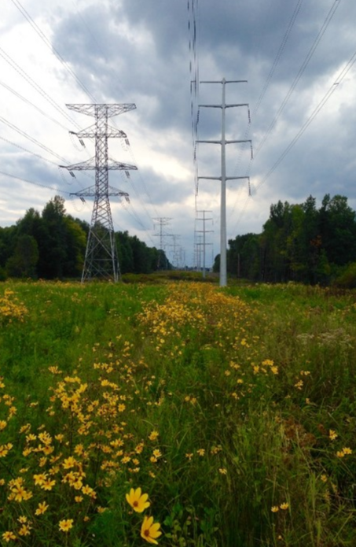

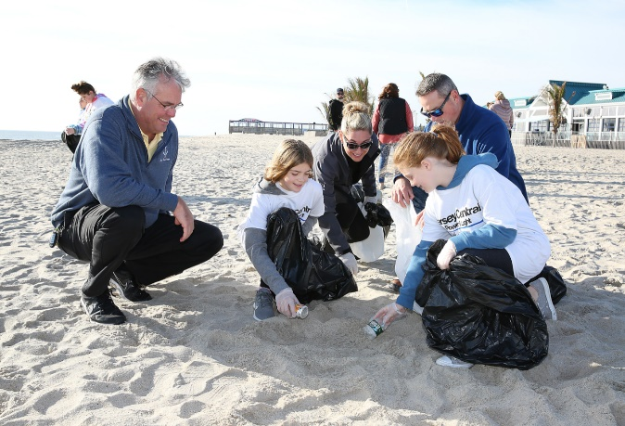

Company Introduction – A Strong Presence in N.J.
Over the past decade, JCP&L economic development efforts have helped facilitate more than 7,000 new jobs and $1.7 billion in investment in N.J.
In 2020, we purchased more than $498 million in local goods and services.
  Over 41% of N.J. purchases come from diverse suppliers.
A primary goal of FirstEnergy and JCP&L is to put their
customers and the environment first.
  JCP&L is the first and only electric utility to be named to
  the N.J. Dept. of Environmental Protection’s
  Sustainable Business Registry.
  Additional environmental recognition includes the
  Certificate of Innovation in Sustainability (NJDEP) and
  Environmental Leadership Award (Commerce &
  Industry Association of N.J.)

Slide 4
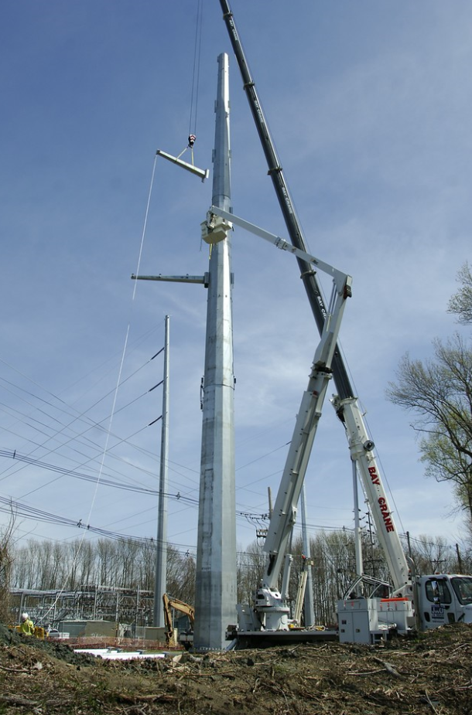
Company Introduction – Transmission
As part of its commitment to its customers, JCP&L, in coordination with PJM, engages in planning for its transmission system.
We invested more than $300 million in projects to strengthen our system in 2020.
JCP&L and FirstEnergy have decades of experience with systematic transmission upgrades and expansions as a result of new energy generation.
We are familiar with PJM’s Regional Transmission Expansion Plan (“RTEP”) and have successfully resolved reliability violations in the past through the RTEP process.

Slide 5
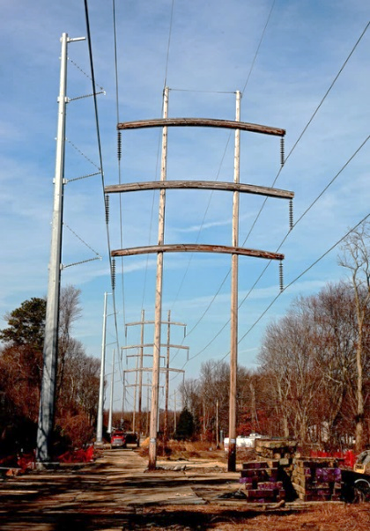
Summary Statement
Develop a transmission solution to enable incorporation of offshore wind into the New Jersey transmission system that:
  Minimizes environmental impact;
  Minimizes impact to communities;
  Maximizes the use of existing substations, transmission corridors and rights-of-way;
  Facilitates connection of offshore wind by creating interconnections closer to the shore.
JCP&L proposal utilizes existing transmission corridors and substations.
  Enhances the transmission system to meet the requested offshore imports.
  Minimizes the risk of not being able to construct facilities.
Construction schedule starts October 2025 and completes June 2032, with work phased to the solicitation schedule.
Developed in cooperation with Mid-Atlantic Offshore Development, LLC (MAOD), a new joint-venture of Shell New Energies US, LLC and EDF Renewables North America.

Slide 6
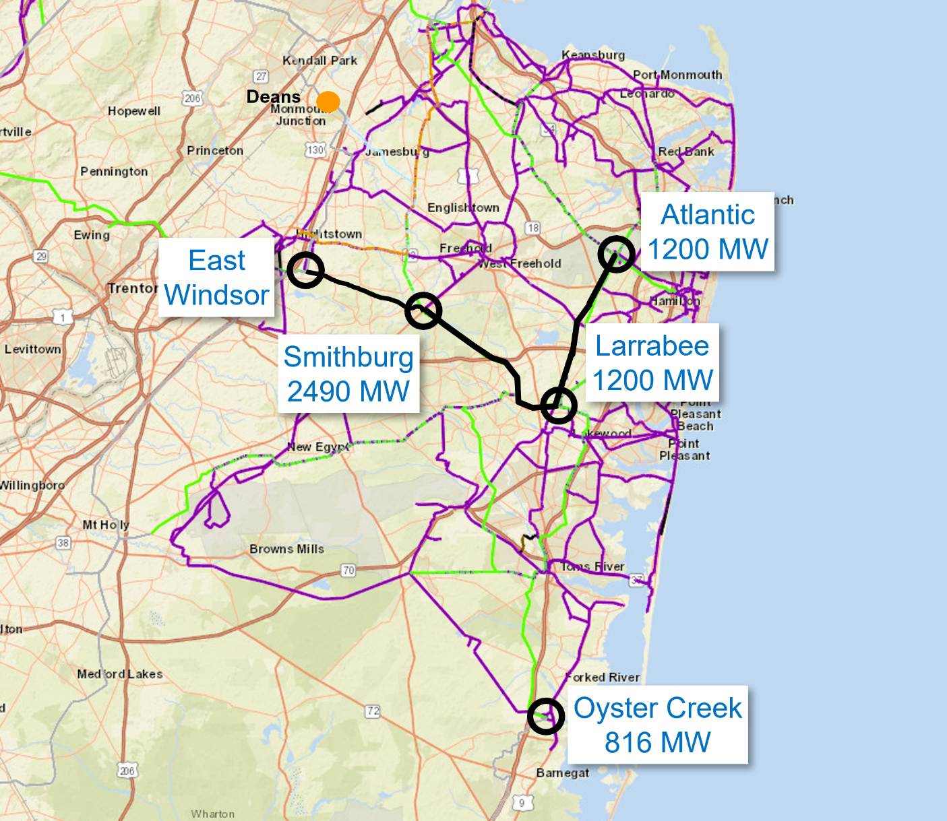
Proposed Offshore Wind Injection Points
Location | MW Injected
Smithburg | 2490
Larrabee | 1200
Atlantic | 1200
Oyster Creek | 816
Total | 5706
Deans
Atlantic
1200 MW
East
Windsor
Smithburg
2490 MW
Larrabee
1200 MW
Benefits:
Close proximity to coastline
Utilize 100% existing rights of way
No greenfield development
Oyster Creek
816 MW
Notes:
Major Infrastructure Upgrades: Atlantic, Larrabee, Smithburg, & East Windsor Substation Expansions, East Windsor - Smithburg 500 kV Line, Larrabee Converter – Smithburg 500 kV Lines (2 circuits), & Larrabee Converter – Atlantic 230 kV Line

Slide 7
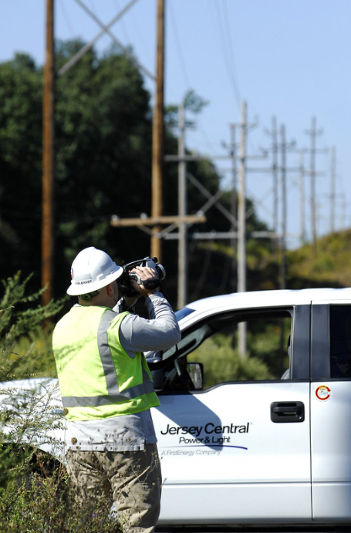
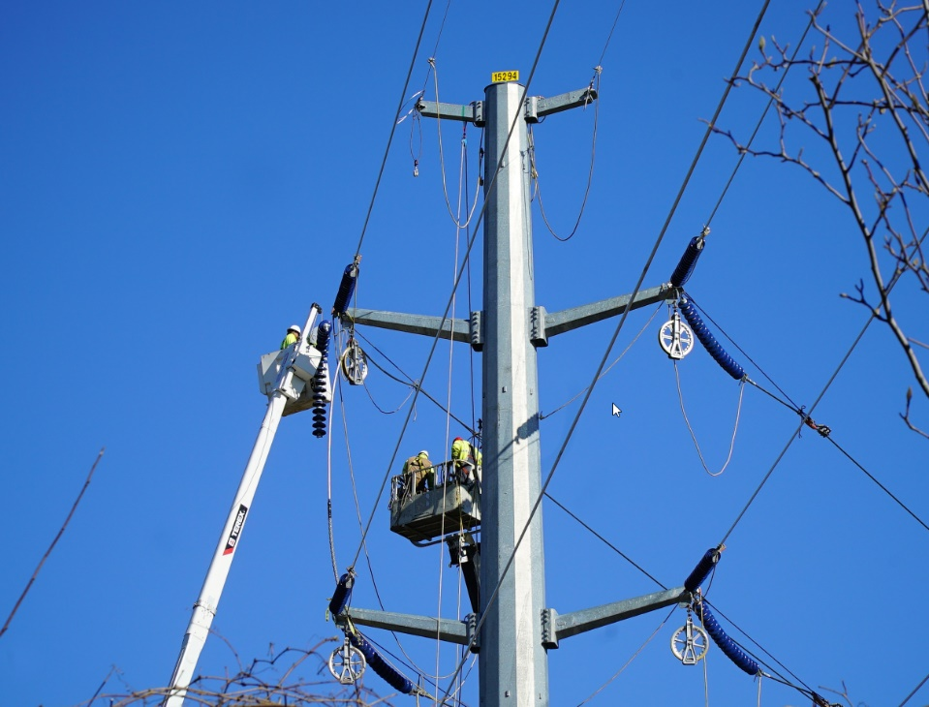
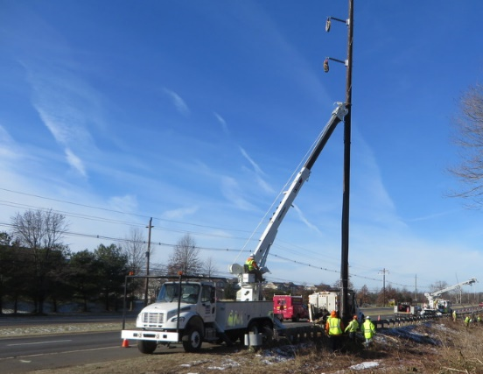
Upgrading Infrastructure & Protecting the Environment
Major infrastructure upgrades:
  Expansions of Smithburg, East Windsor and Atlantic substations
  East Windsor – Smithburg 500 kV Line
  Larrabee Converter – Smithburg 500 kV Line (2 circuits)
  Larrabee Converter – Atlantic 230 kV Line
Leveraging existing facilities and right-of-way
  100% on existing right-of-way
Minimize impacts to the extent practical to regulated areas

Slide 8
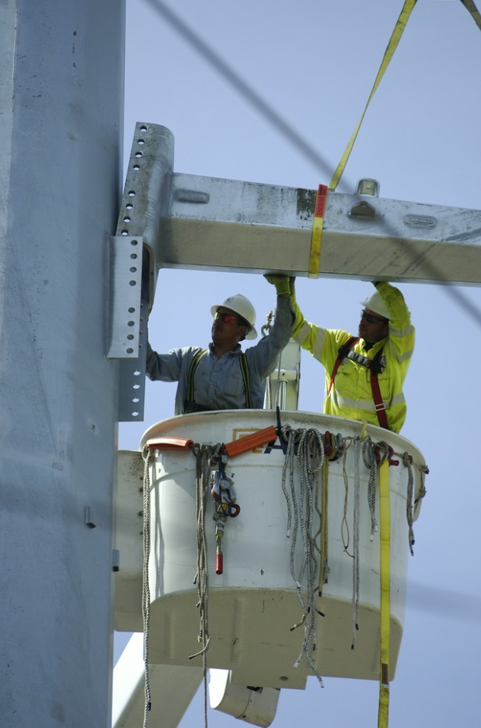
Summary
JCP&L is a local utility with a focus on environmentally sustainable practices, committed to our customers and the state of N.J.
Our proposal maximizes the injection of offshore-generated electricity by enhancing the transmission system and placing interconnection points closer to shore.
JCP&L’s plan effectively enables renewable energy services to customers while minimizing impacts to the environment and local communities by utilizing 100% existing rights-of-way and maximizing the use of existing substations and transmission corridors.
Transmission

Slide 9
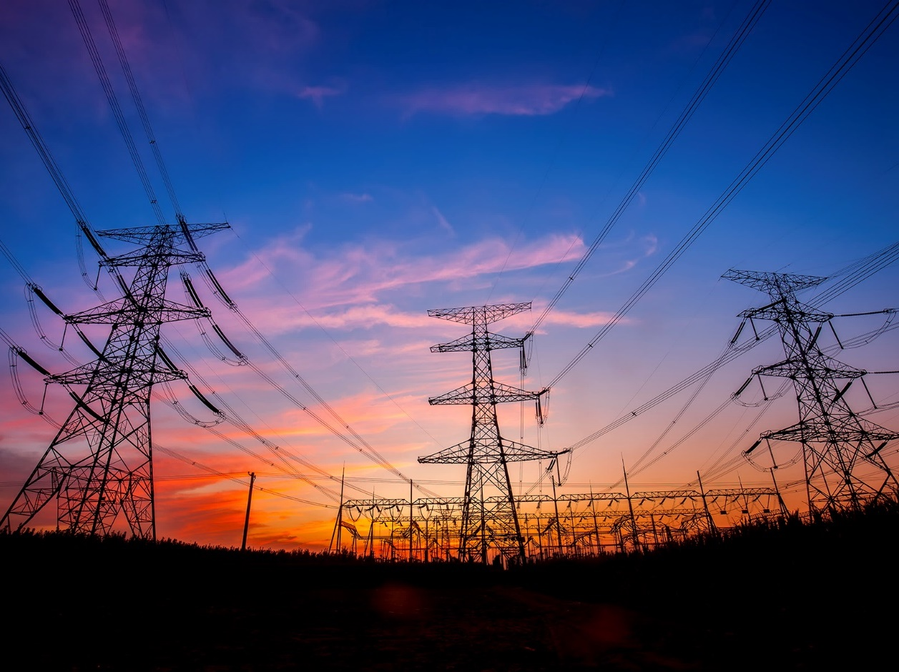

Transmission
Thank You
Thank You
Focused on Our Future

